Slide 1

Lesson 4: Privacy and Social Media

Slide 2

Protecting Your Privacy:The Hidden Dangers of Social Media
In a world where likes, shares, and follows dominate communication, social media has become second nature to people. Platforms like Instagram, Snapchat, TikTok, and Facebook offer creative outlets and ways to stay connected, but they also come with serious risks when personal information isn’t protected. Understanding the dangers of oversharing, weak passwords, and a permanent digital footprint is crucial for staying safe online.

Slide 3


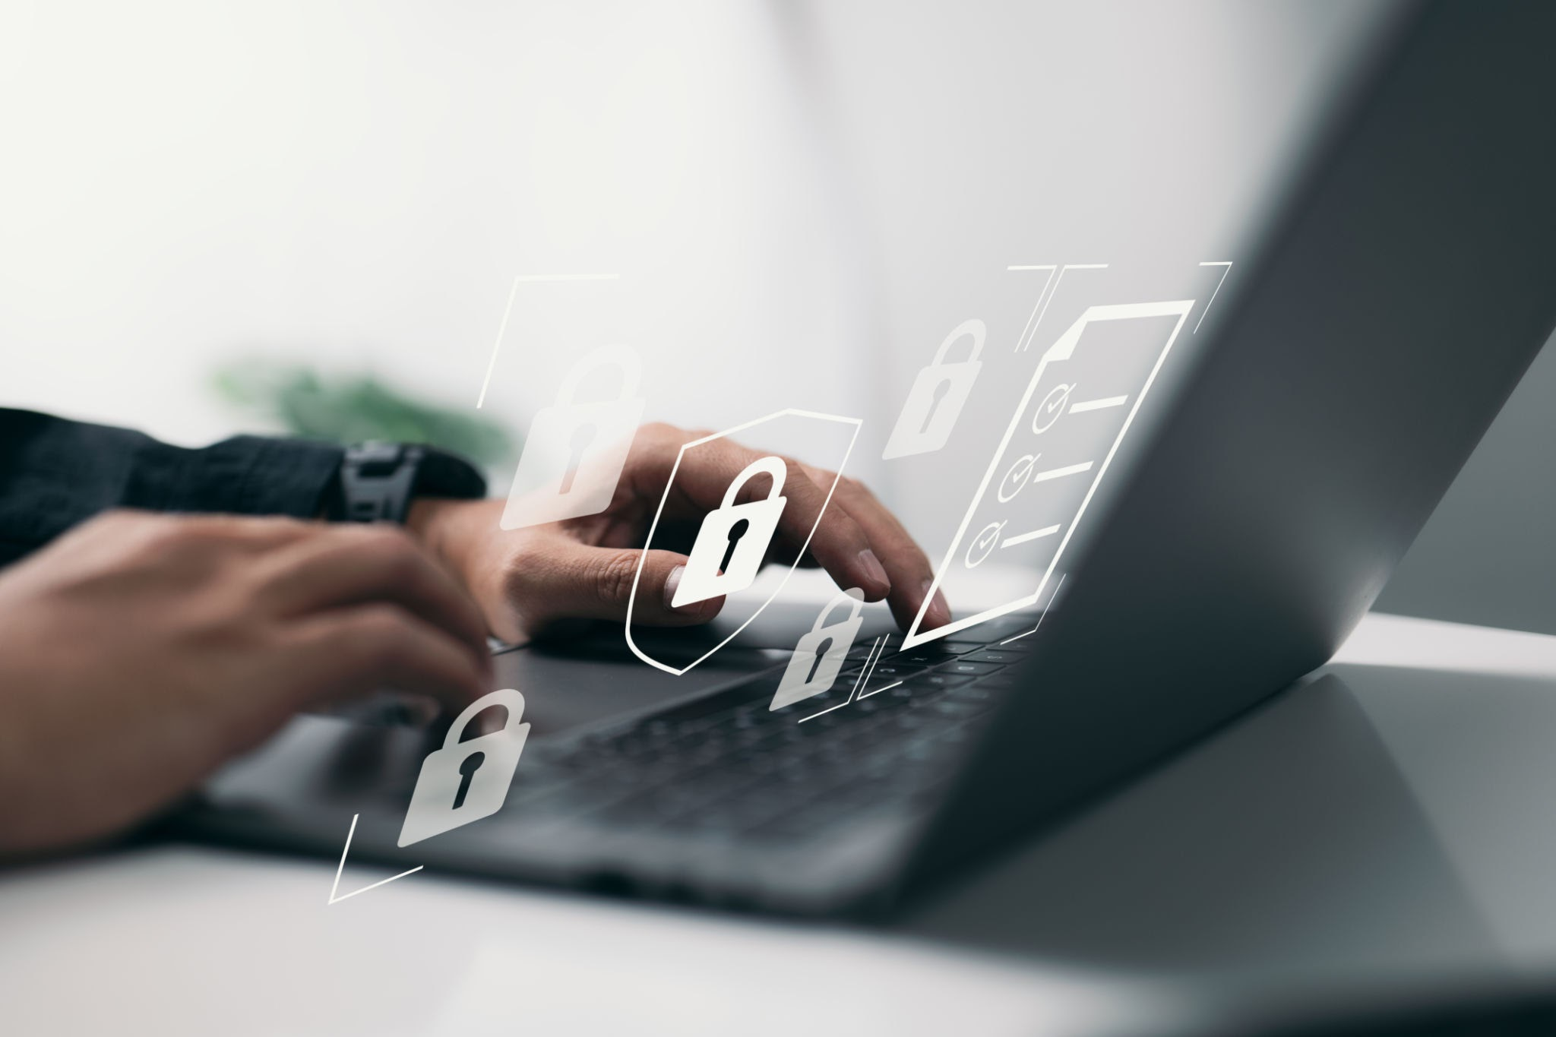
Why Cybersecurity Awareness Matters
Many people underestimate how much personal data they reveal every day. Without strong cybersecurity habits, anyone can fall victim to identity theft, cyberbullying, or even real-world danger. Cybersecurity isn’t just a tech concern, it’s a life skill. Knowing how to protect your online presence helps prevent hackers, scammers, and even strangers from accessing sensitive information.

Slide 4
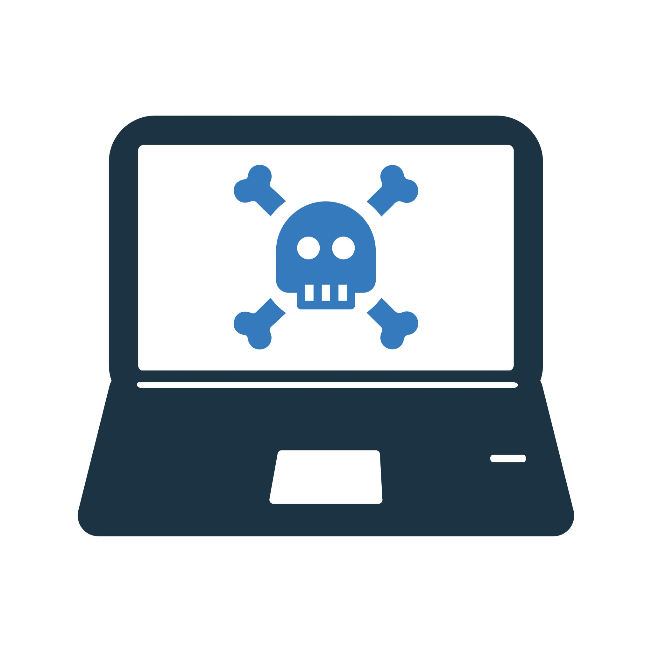

The Risks of a Permanent Digital Footprint👣
Every photo, comment, and post you share becomes part of your digital footprint. Even if you delete it, someone could have already taken a screenshot or archived it. Colleges, future employers, and others may search your name online, and what they find can influence their opinion of you.
Consequences include:
• Missed opportunities: Inappropriate or offensive posts can lead to rejected college or job applications.
• Embarrassment: Old posts might resurface at the worst times.
• Privacy loss: Shared photos can be reused or re posted without permission.
Password Weakness = Easy Target
Using simple or repeated passwords across platforms makes it easier for hackers to break into your accounts. A weak password is like leaving your front door unlocked. Once inside, a hacker can:
• Send messages pretending to be you
• Access private conversations or photos
• Steal your identity or banking information
Good Cyber habits include:
• Use long, unique passwords for each account
• Turn on two-factor authentication
• Never share your passwords with friends or online

Slide 5

PHOTO SHARING: Harmless or Harmful?🤳🏻
It might feel harmless to post a selfie in your school uniform or tag your current location in a story, but this information can reveal more than you think. Cyberstalkers and predators use photos to track where you live, study, or hang out.
Be cautious about:⚠️
• Photos with house numbers, school logos, or license plates
• Family photos of young siblings or children
• Real-time location tags that show where you are now
How to Stay Safe on Social Media✅
1. Review your privacy settings regularly on all platforms.
2. Think before you post, would you be okay with a teacher, parent, or future boss seeing it?
3. Avoid sharing personal details like your address, birthday, school, or work online.
4. Audit your profiles, delete anything outdated or risky.
5. Educate your friends, keeping each other safe helps everyone.
Social media can be a powerful tool for connection, creativity, and learning, but only when used wisely. As a student, your online choices shape your future and your safety. A moment of awareness today can prevent a lifetime of problems tomorrow. Be smart, be secure, and protect your digital self.

Slide 6
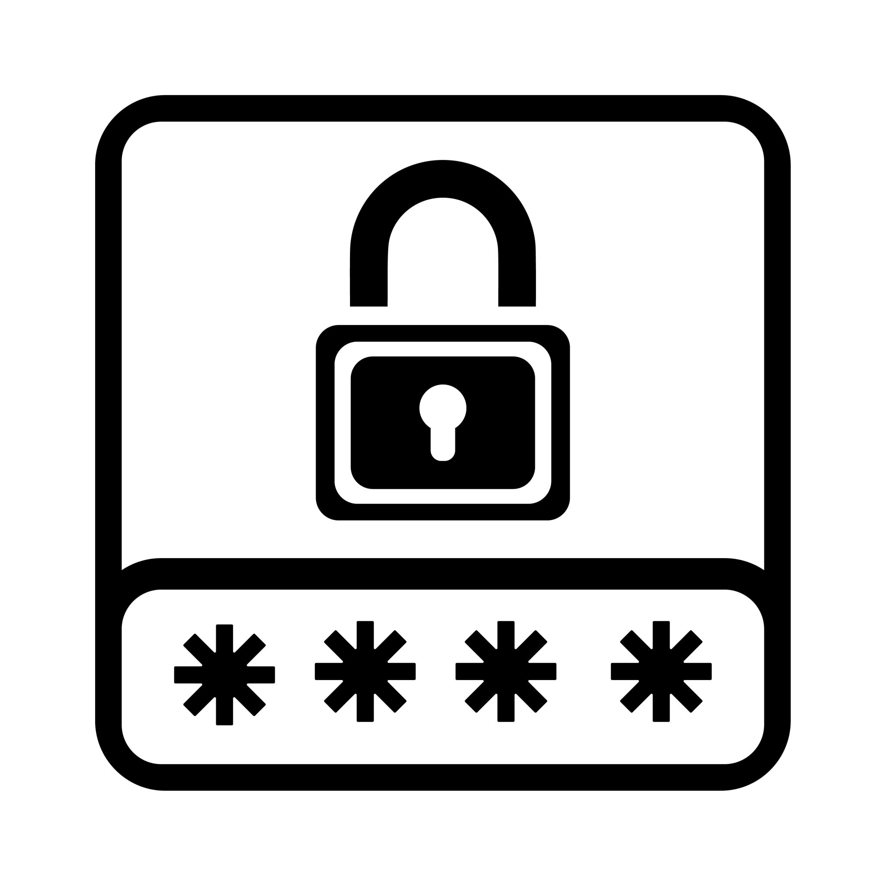

Detailed step-by-step demo on how students (or any user) can adjust their Facebook and Instagram settings to avoid hacking, control their privacy, and protect sensitive information🔒
FACEBOOK PRIVACY & SECURITY SETTINGS DEMO
1. Enable Two-Factor Authentication
Steps:
1. Go to Settings & Privacy > Settings > Security and Login
2. Scroll to Two-Factor Authentication
3. Click Edit next to Use two-factor authentication
4. Choose your method (e.g., Text Message (SMS) or Authentication App)
5. Follow prompts to complete setup
Why it matters: It adds a second layer of security even if your password is stolen.
2. Set Who Can See Your Posts
Steps:
1. Go to Settings > Privacy
2. Under Your Activity, change:
3 Who can see your future posts? → Set to Friends (or Only Me for private use)
4 Limit Past Posts → Click Limit to restrict older posts to Friends only
Why it matters: Prevents strangers or public viewers from seeing personal content.

Slide 7

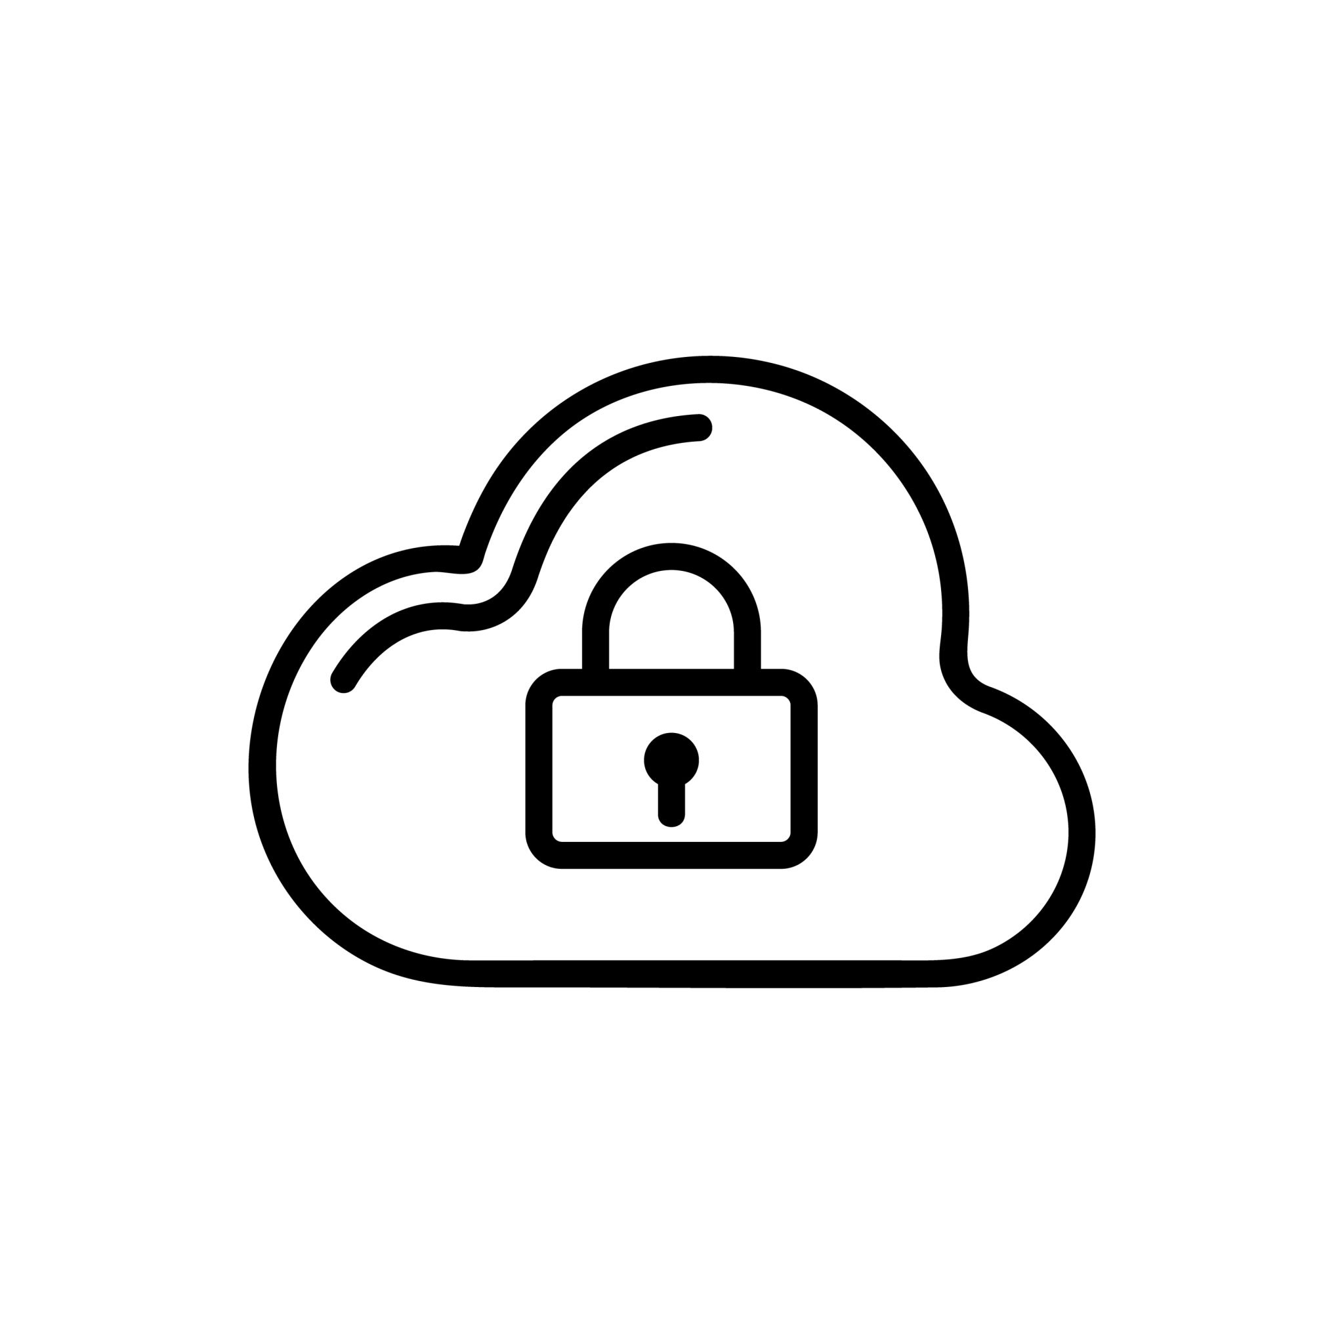
FaceBook Privacy Security Settings⚙️
3. Check Profile Visibility
Steps:
1. Go to your Profile
2. Click on Edit Details
3. Hide/remove sensitive info like:
4 Phone number
5 Birthdate
6 School, workplace, address
7 Family relationships (especially minors)
Why it matters: Limits data that can be used for identity theft or targeting.
4. Control Who Can Look You Up
Steps:
1. Go to Settings > Privacy
2. Under How People Find and Contact You, adjust:
3 Who can send you friend requests? → Friends of Friends
4 Who can look you up using your email/phone? → Only Me
5 Do you want search engines to link to your profile? → No
5. Review Tagged Photos and Posts
Steps:
1. Go to Settings > Profile and Tagging
2. Set:
3 Who can see posts you’re tagged in? → Friends or Only Me
4 Review tags people add to your posts before the tags appear? → Enable
Why it matters: Prevents being tagged in harmful or embarrassing content.

Slide 8

INSTAGRAM PRIVACY & SECURITY SETTINGS DEMO
1.Make Your Account Private
Steps:
1. Open Instagram App
2. Go to Profile > Menu (three lines) > Settings and Privacy
3. Tap Account Privacy
4. Turn on Private Account
Why it matters: Only approved followers can see your posts and stories.
2. Enable Two-Factor Authentication
Steps:
1. Go to Settings and Privacy > Accounts Center > Password and Security
2. Tap Two-Factor Authentication
3. Choose account and tap Turn On
4. Select Authentication App or Text Message and follow instructions
Extra Tips for Both Platforms
• Log Out on Shared Devices
• Avoid Public Wifi for Login
• Never Share Passwords
• Report Suspicious Messages Immediately

Slide 9
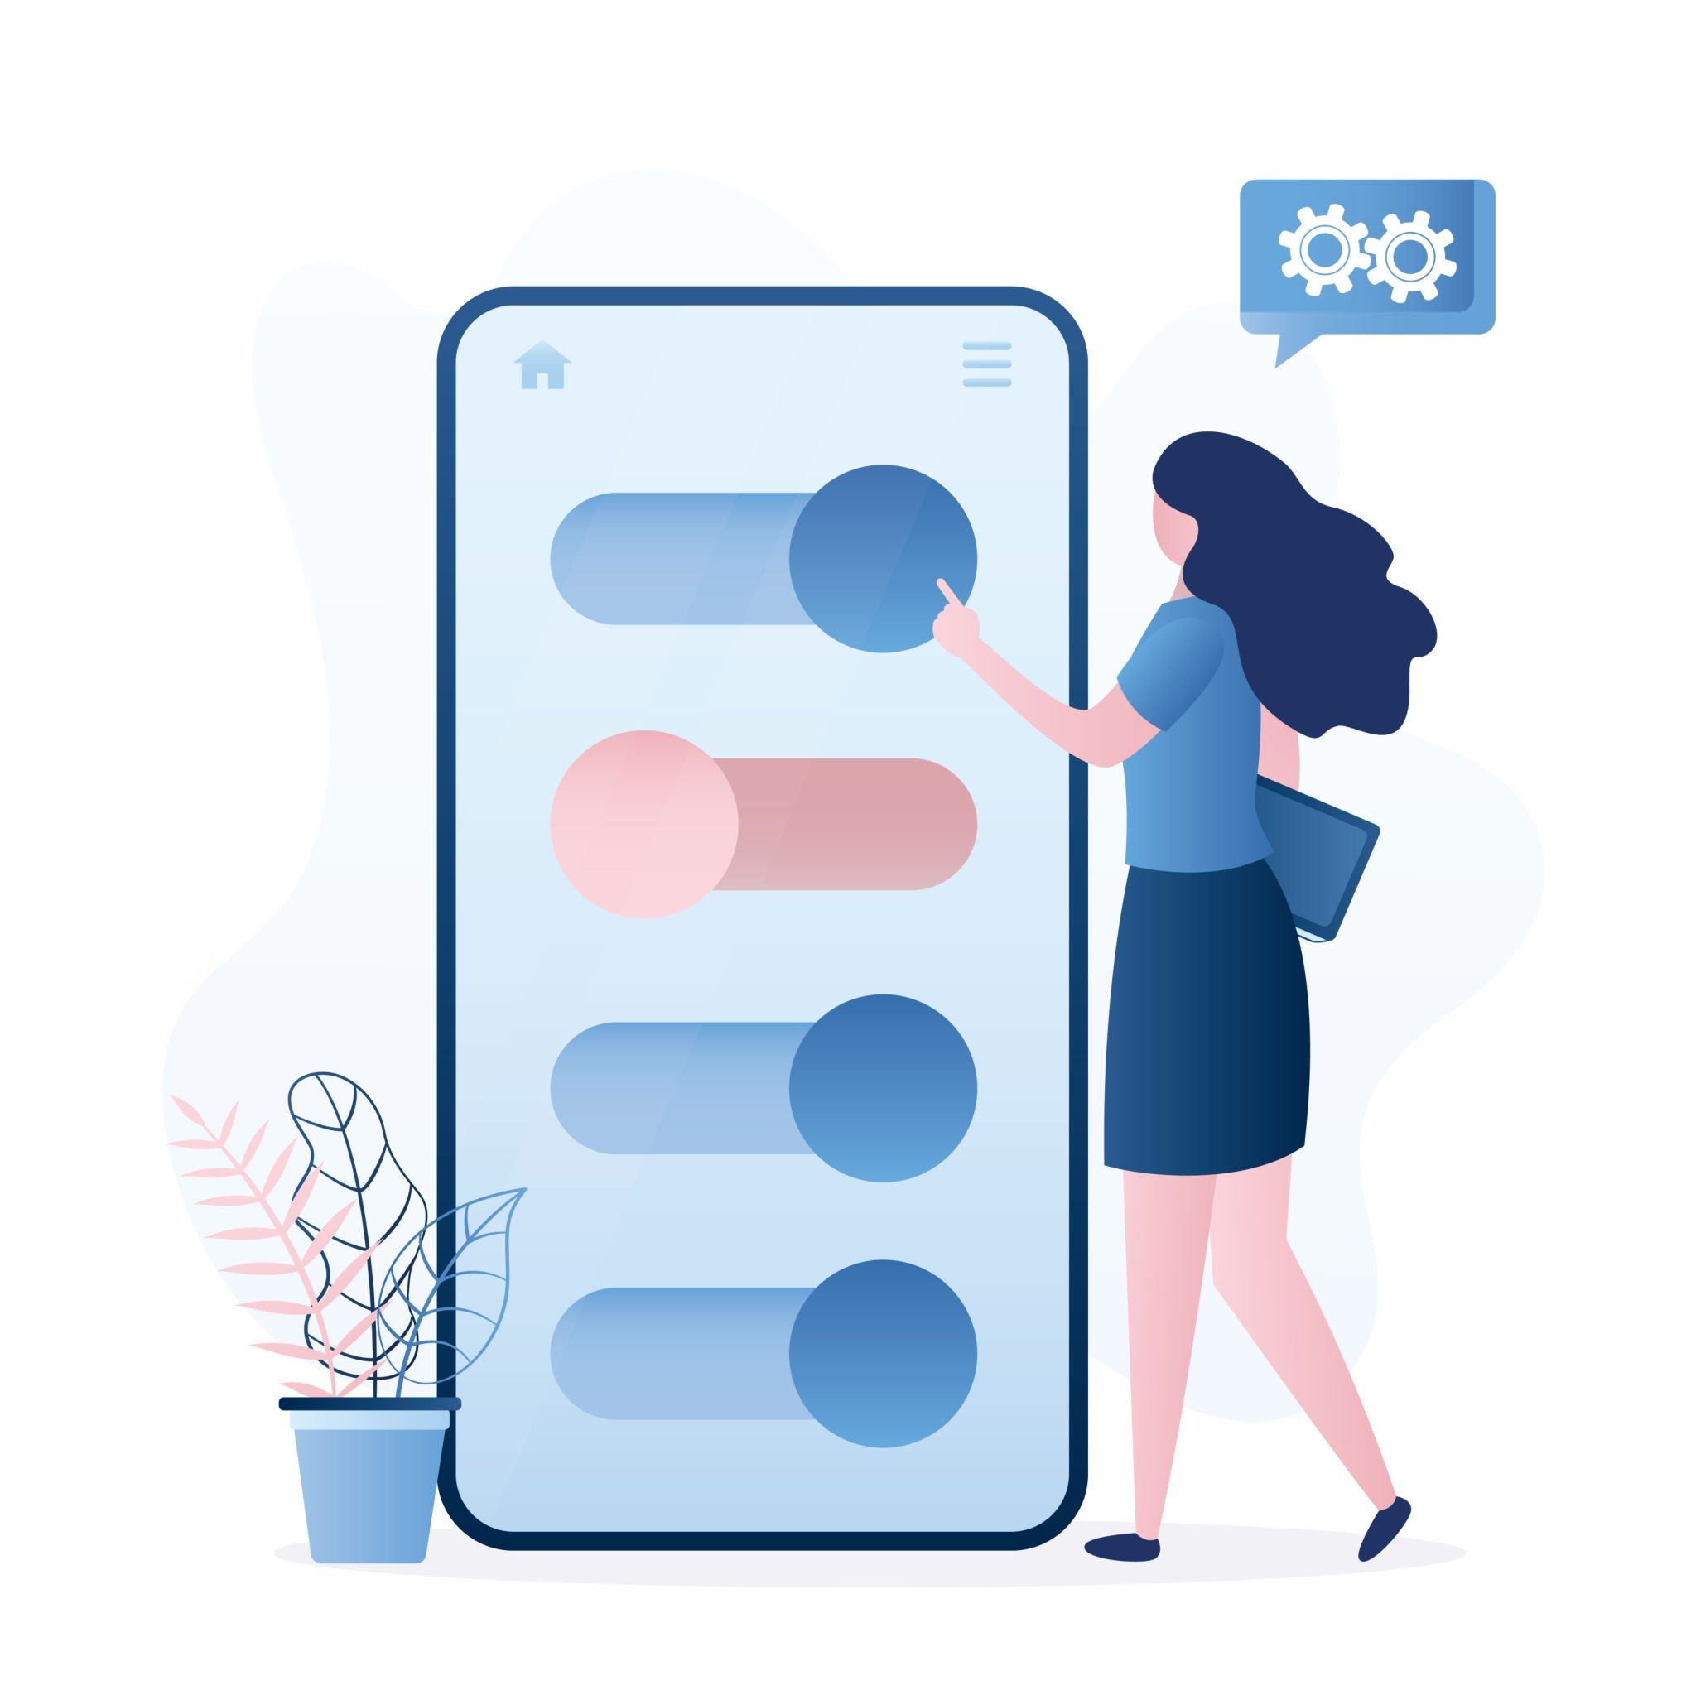
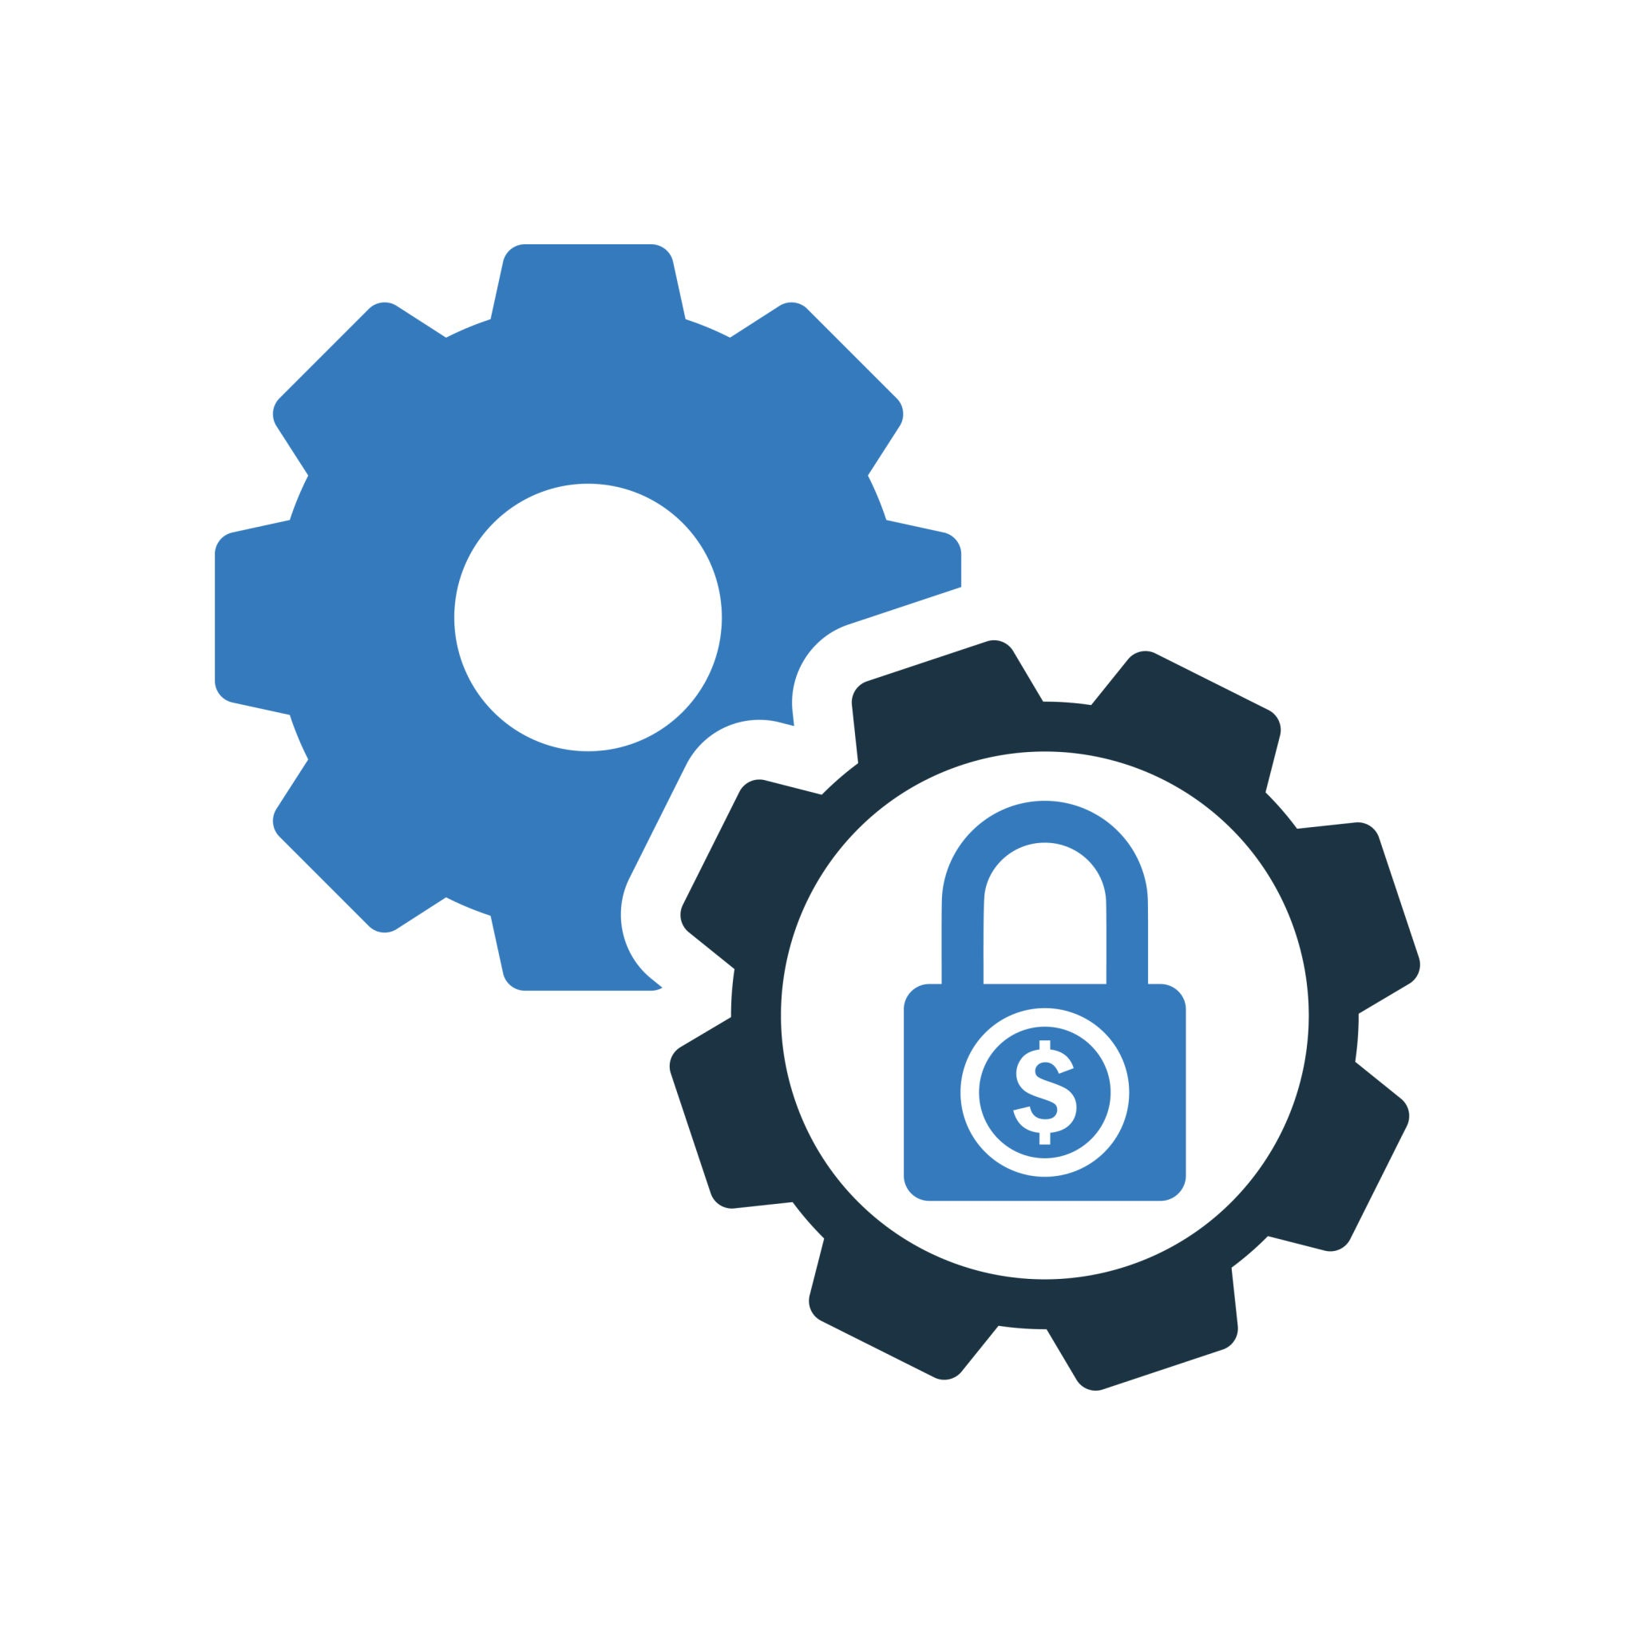
How Can You Review Your Own Social Media Profiles?💭
Step 1: Google Yourself
• Search your full name, usernames, and any email handles.
• Check images, links, and old accounts.
• Ask: What does a stranger or future employer see about me online?
Step 2: Review Privacy Settings
Step 3: Check Your Profile Info
• Have I listed my full name, school, birthdate, or location?
• Are my contact details (phone, email) visible?
• Do I have links to other public platforms?
If yes, remove or hide sensitive details.
Step 4: Audit Posts, Stories & Photos
• Delete anything that is:Too personal (location tags, school name, family)
Step 5: Review Followers & Friends
• Unfollow or remove:Ask yourself: Would I feel safe with all of these people seeing my daily life?
Step 6: Check Third-Party App Access
• Visit your account settings > apps and websites.
Step 7: Enable Two-Factor Authentication
• Go to security settings
• Turn on 2FA for added login protection

Slide 10
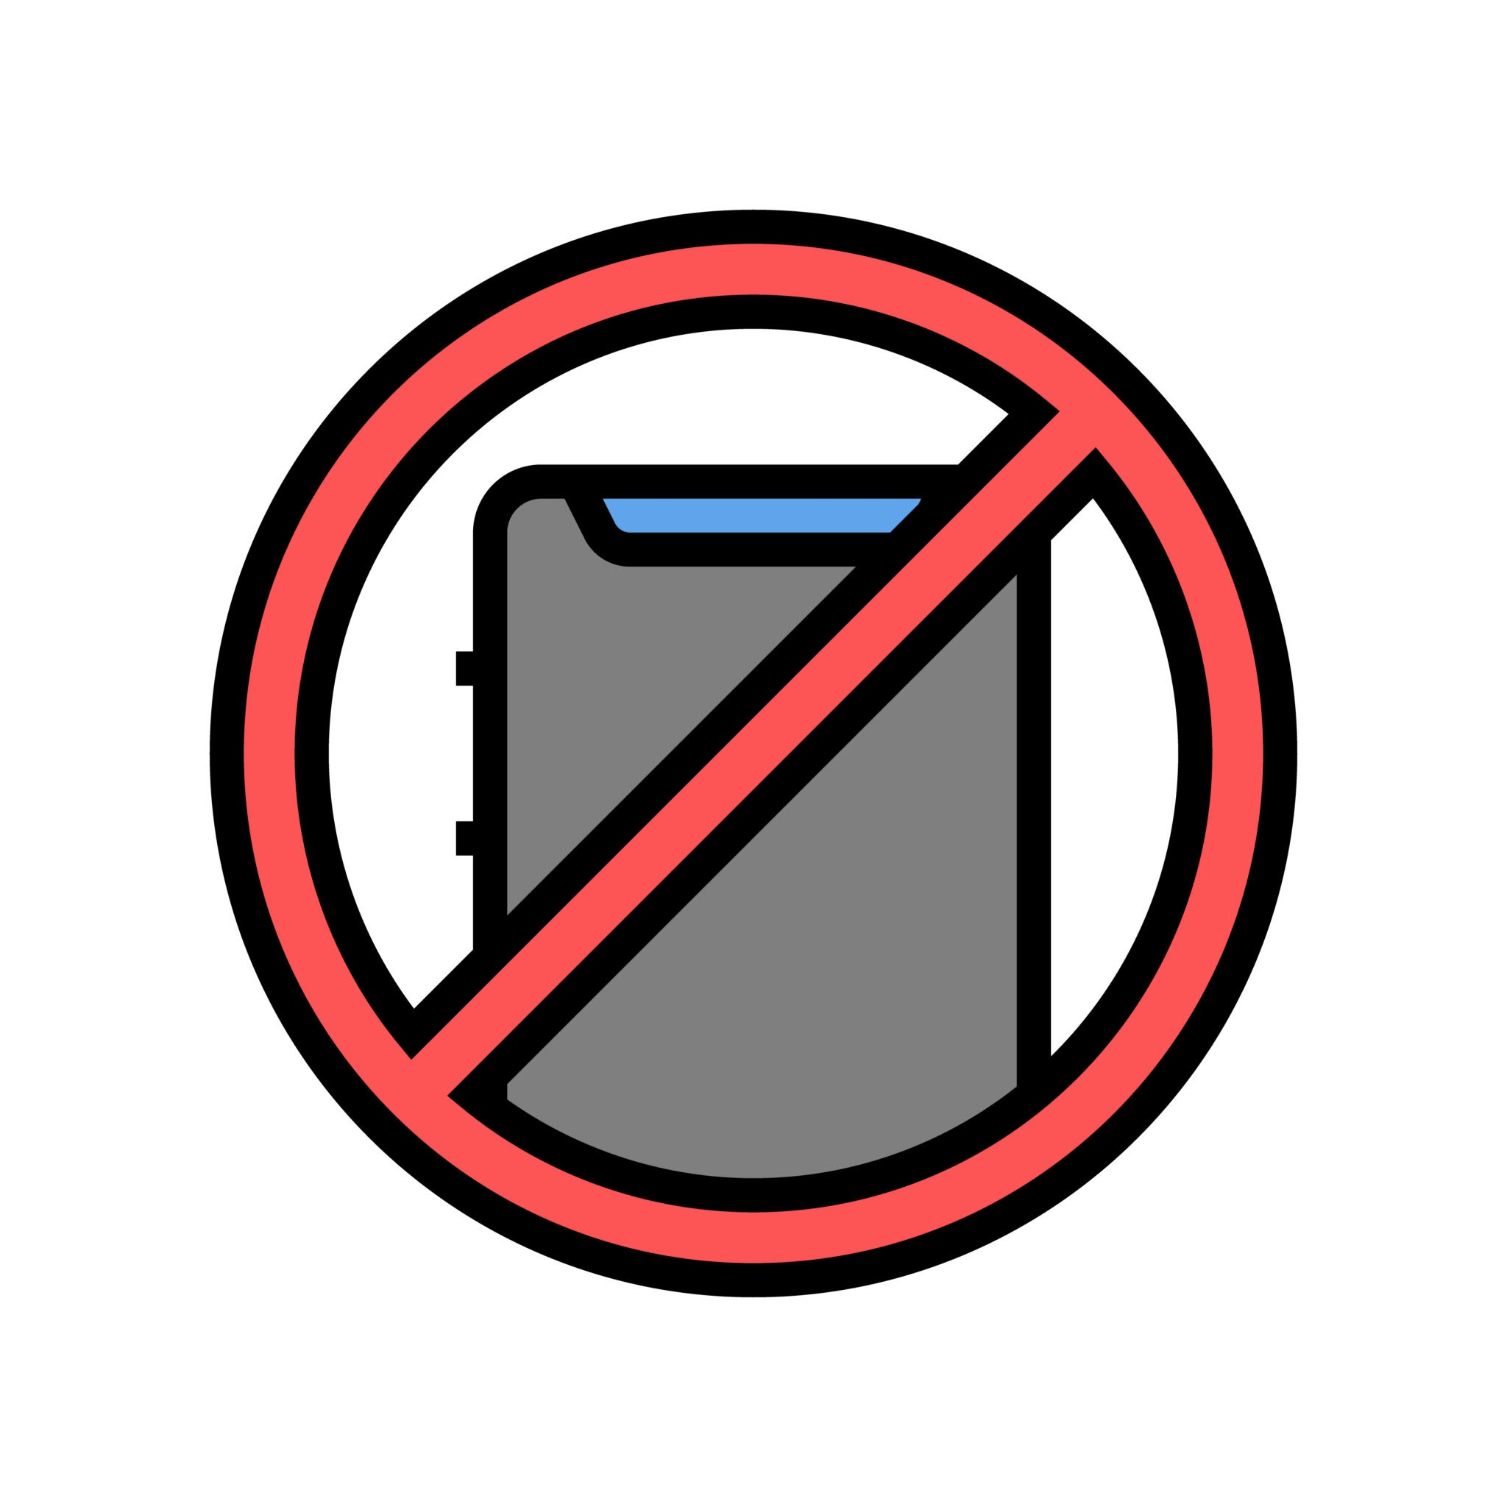
What NOT to Share Online!🚫
Protect Your Privacy. Stay Safe.
Use this checklist to review your social media posts, bios, captions, and shared content.
1.Personal Information
2.Location & Daily Routines
3.Images showing house number, street signs, or license plates
4.Security Risks:Password clues (e.g., pet names, mother’s maiden name
5.Offensive jokes, memes, or controversial comments
6.False information or rumors
7.Screenshots of private conversations
8.Financial info (bank details, credit cards, etc.)
9.Inappropriate or revealing selfies
Pro Tip:
Before posting, ask yourself:
Would I be okay with my teacher, parent,child,or future employer seeing this?

Slide 11

Are you ready to prove your social media and digital awareness skills? Click the link below and take the quiz💡
Kindly refer to quizzes folder
Social Media Safety & Digital Awareness Quiz

Slide 12
How Social Media & Digital Awareness Connect to the SDGs
Social media and digital awareness play a crucial role in promoting and achieving the Sustainable Development Goals (SDGs). These platforms serve as powerful tools for raising awareness, mobilizing communities, fostering collaboration, and driving action toward global sustainability efforts.
1. Peace, Justice, and Strong Institutions: Significantly reduce violence and protect children from abuse and exploitation.
Teaching children and teens how to avoid oversharing and how to report online threats supports a safer, more just digital environment.
2. Responsible Consumption and Production: Ensuring that people everywhere have the relevant information and awareness for sustainable lifestyles.Digital awareness includes understanding the impact of online behavior, digital footprints, and the ethical use of technology and media.
3. Reduced Inequalities: Empower and promote the social, economic, and political inclusion of all.
Social media awareness helps prevent digital exclusion, misinformation, and discrimination, making online platforms safer and more inclusive for marginalized groups.
4. Gender Equality: Eliminate all forms of violence against women and girls, including online harassment.
Digital awareness empowers girls to protect themselves against cyberbullying, doxxing, and online exploitation, while also promoting respectful digital spaces for all genders.

Slide 13
How Social Media & Digital Awareness Connect to the SDGs
5. Quality Education: Ensure learners acquire the knowledge and skills needed to promote sustainable development, including through digital literacy and online safety.
Connection: Teaching students to be digitally aware and safe on social media equips them with critical 21st-century skills, helping them navigate digital spaces responsibly.
6.Empowers Communities – Social media gives marginalized voices a platform to share their experiences and advocate for change.
7.Promotes Innovation – Digital technologies drive solutions for sustainable development, from smart cities to eco-friendly business models.
8.Facilitates Collaboration – Online networks connect stakeholders, fostering partnerships between governments, businesses, and NGOs.
9.Encourages Advocacy – Social media enables individuals and organizations to campaign for policy changes and sustainable practices.
10.Amplifies Awareness – Digital platforms spread information about SDGs, educating people on global challenges.

